Slide 1
Lecture No. 04
Fundamentals OF Computer Programming

Slide 2
Conditional Statements

Slide 3
The if Statement

Slide 4
The if Statement
Allows statements to be conditionally executed or skipped over
Models the way we mentally evaluate situations:
  "If it is raining, take an umbrella."
  "If it is cold outside, wear a coat."

Slide 5
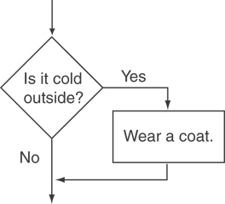
Flowchart for Evaluating a Decision

Slide 6
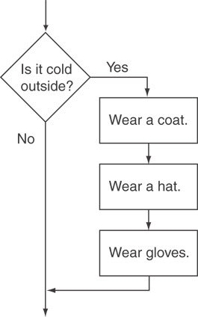
Flowchart for Evaluating a Decision

Slide 7
The if Statement
General Format:
  if (expression)
  statement;

Slide 8
The if Statement-What Happens
To evaluate:
  if (expression)
  statement;
If the expression is true, then statement is executed.
If the expression is false, then statement is skipped.

Slide 9
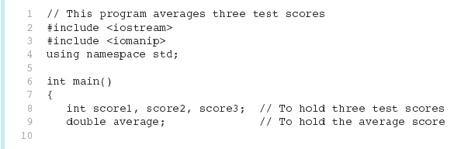
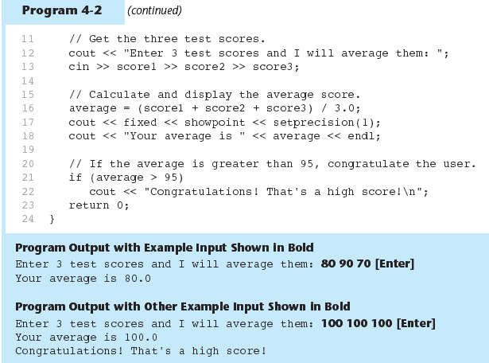
if Statement in Program

Slide 10
if Statement in Program

Slide 11
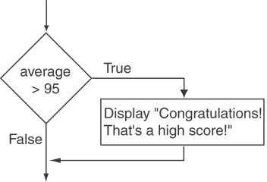
Flowchart for Program Lines 21 and 22

Slide 12
if Statement Notes
Do not place ; after (expression)
Place statement; on a separate line after (expression), indented:
  if (score > 90)
  grade = 'A';
Be careful testing floats and doubles for equality
0 is false; any other value is true

Slide 13
Expanding the if Statement

Slide 14
Expanding the if Statement
To execute more than one statement as part of an if statement, enclose them in { }:
  if (score > 90)
  {
  grade = 'A';
  cout << "Good Job!\n";
  }
{ } creates a block of code

Slide 15
The if/else Statement

Slide 16
The if/else statement
Provides two possible paths of execution
Performs one statement or block if the expression is true, otherwise performs another statement or block.

Slide 17
The if/else statement
General Format:
  if (expression)
  statement1; // or block
  else
  statement2; // or block

Slide 18
if/else-What Happens
To evaluate:
  if (expression)
  statement1;
  else
  statement2;
If the expression is true, then statement1 is executed and statement2 is skipped.
If the expression is false, then statement1 is skipped and statement2 is executed.

Slide 19
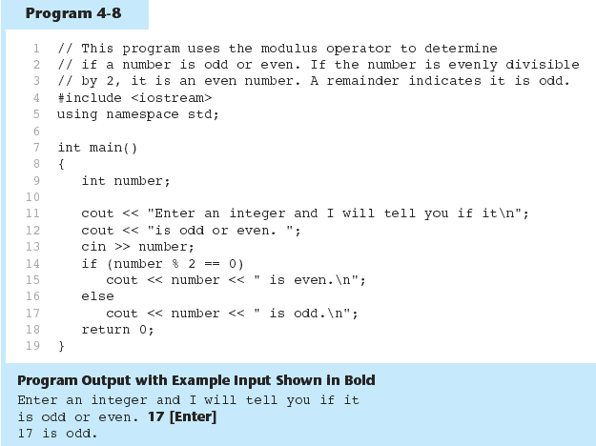
The if/else statement and Modulus Operator

Slide 20
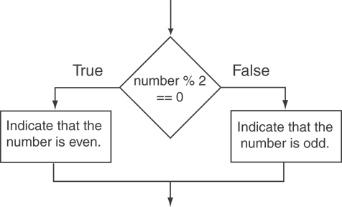
Flowchart for Program Lines 14 through 18

Slide 21
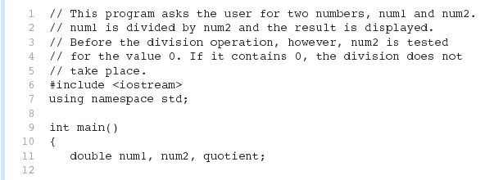
Testing the Divisor in Program

Slide 22
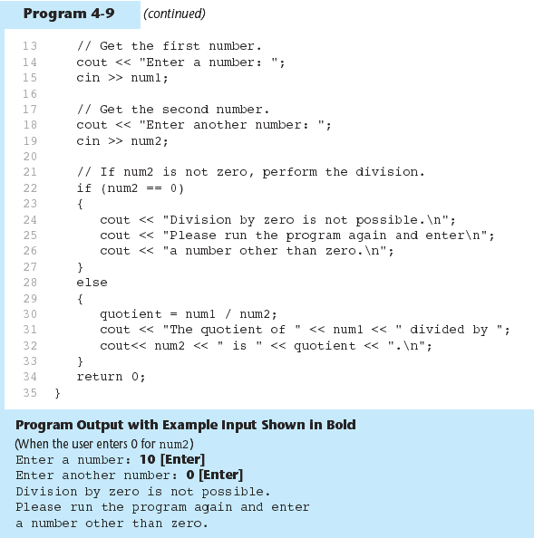
Testing the Divisor in Program

Slide 23
Nested if Statements

Slide 24
Nested if Statements
An if statement that is nested inside another if statement
Nested if statements can be used to test more than one condition

Slide 25
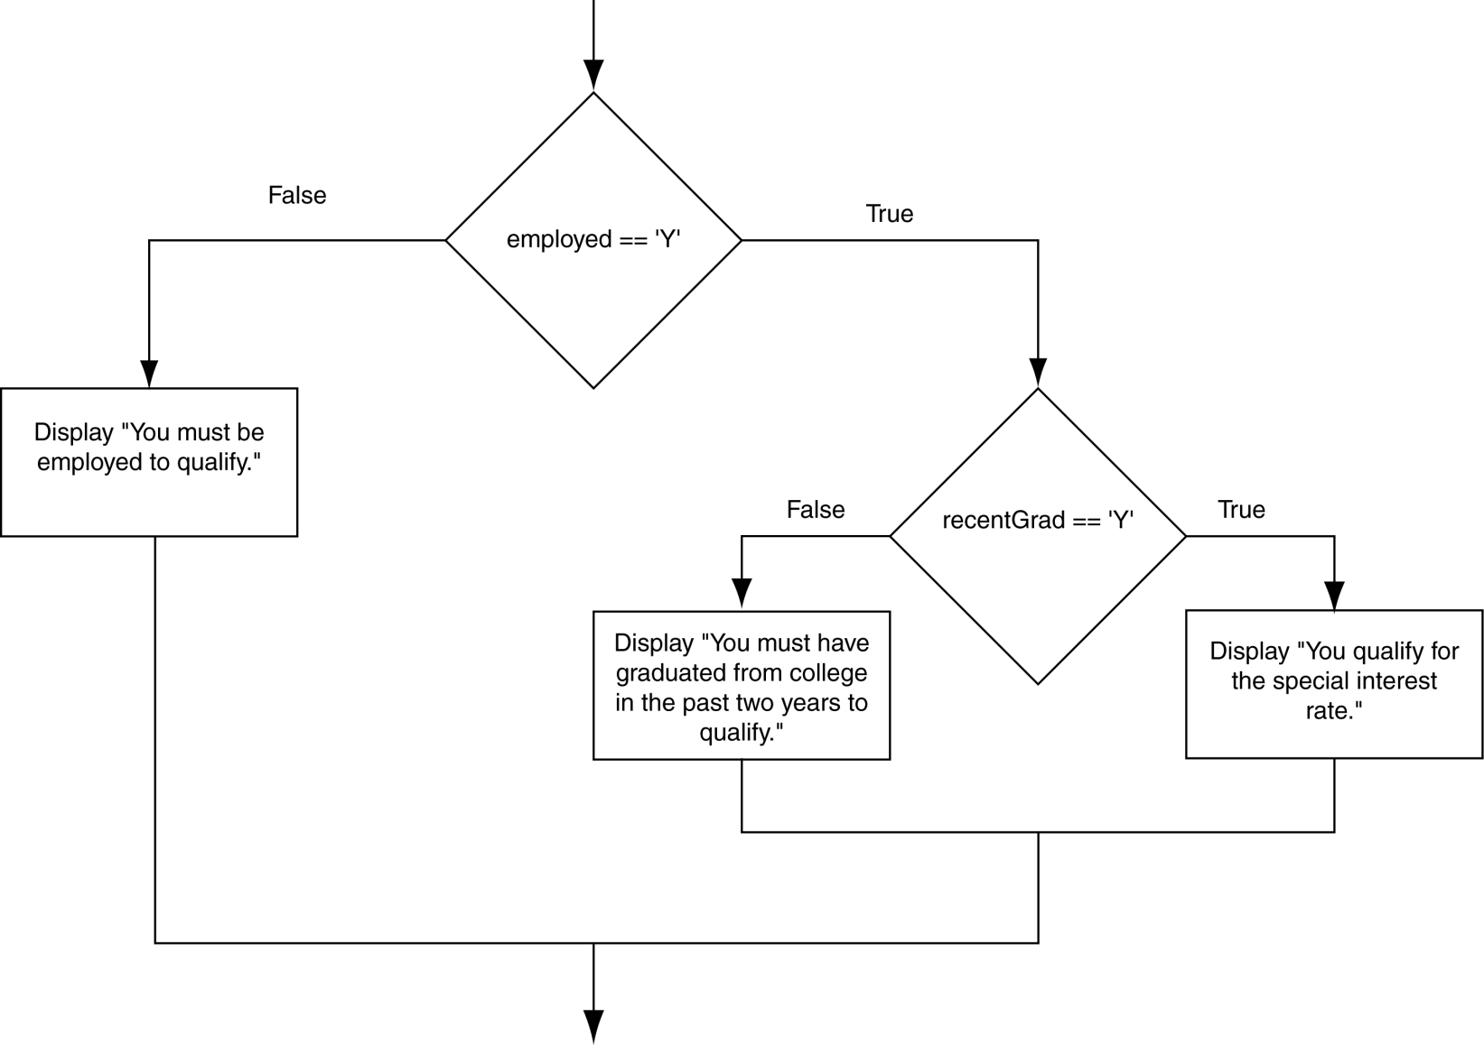
Flowchart for a Nested if Statement

Slide 26
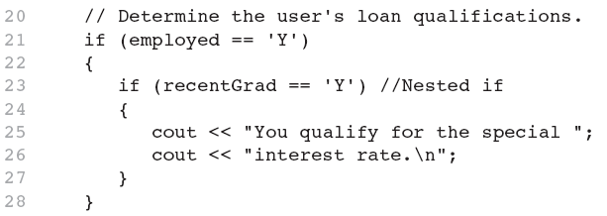
Nested if Statements

Slide 27
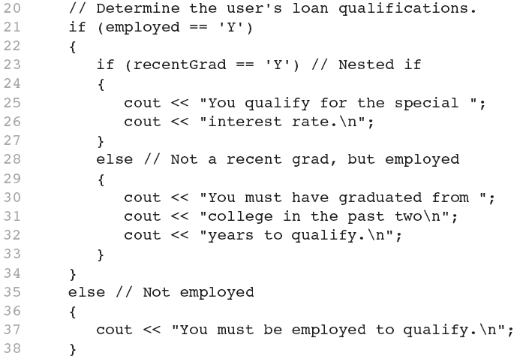
Nested if Statements
Another example, from Program

Slide 28
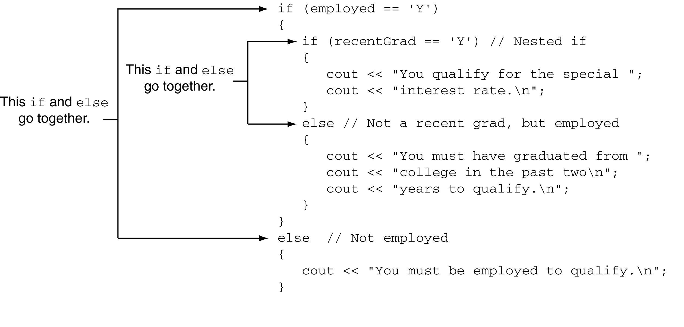
Use Proper Indentation!

Slide 29
The if/else if Statement

Slide 30
The if/else if Statement
Tests a series of conditions until one is found to be true
Often simpler than using nested if/else statements
Can be used to model thought processes such as:
"If it is raining, take an umbrella,
else, if it is windy, take a hat,
else, take sunglasses”

Slide 31
if/else if Format
  if (expression)
  statement1; // or block
  else if (expression)
  statement2; // or block
  .
  . // other else ifs .
  else if (expression)
  statementn; // or block

Slide 32
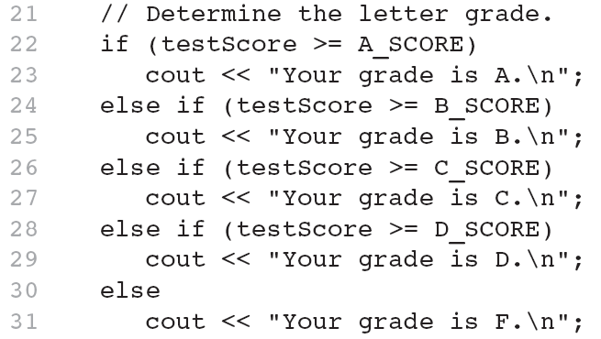
The if/else if Statement in Program

Slide 33
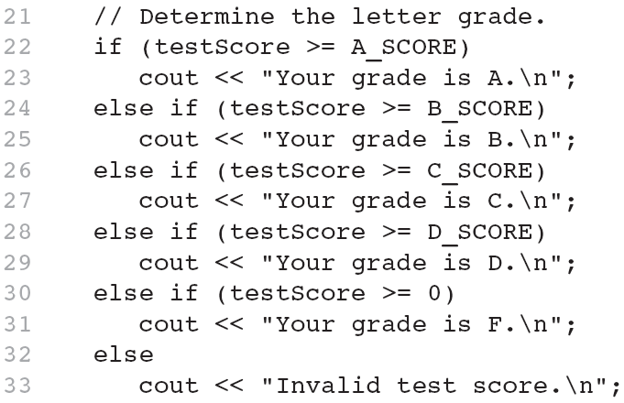
Using a Trailing else to Catch Errors in Program
The trailing else clause is optional, but it is best used to catch errors.
This trailing else catches invalid test scores

Slide 34
Menus

Slide 35
Menus
Menu-driven program: program execution controlled by user selecting from a list of actions
Menu: list of choices on the screen
Menus can be implemented using if/else if statements

Slide 36
Menu-Driven Program Organization
Display list of numbered or lettered choices for actions
Prompt user to make selection
Test user selection in expression
  if a match, then execute code for action
  if not, then go on to next expression

Slide 37
Validating User Input

Slide 38
Validating User Input
Input validation: inspecting input data to determine whether it is acceptable
Bad output will be produced from bad input
Can perform various tests:
  Range
  Reasonableness
  Valid menu choice
  Divide by zero

Slide 39
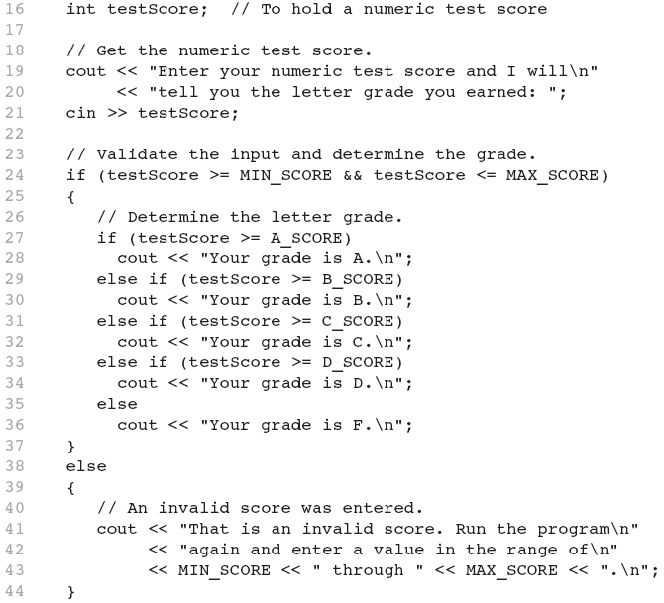
Input Validation in Program

Slide 40
The Conditional Operator

Slide 41
The Conditional Operator
Can use to create short if/else statements
Format: expr ? expr : expr;
x<0 ? y=10 : z=20;
First Expression:
Expression to be
tested
2nd Expression:
Executes if first
expression is true
3rd Expression:
Executes if the first
expression is false

Slide 42
The Conditional Operator
The value of a conditional expression is
  The value of the second expression if the first expression is true
  The value of the third expression if the first expression is false
Parentheses () may be needed in an expression due to precedence of conditional operator

Slide 43
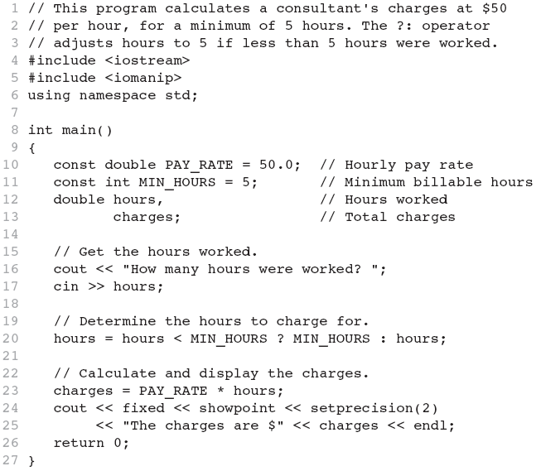
The Conditional Operator in Program

Slide 44
The switch Statement

Slide 45
The switch Statement
Used to select among statements from several alternatives
In some cases, can be used instead of if/else if statements

Slide 46
switch Statement Format
switch (expression) //integer
{
case exp1: statement1;
case exp2: statement2;
...
case expn: statementn;
default: statementn+1;
}

Slide 47
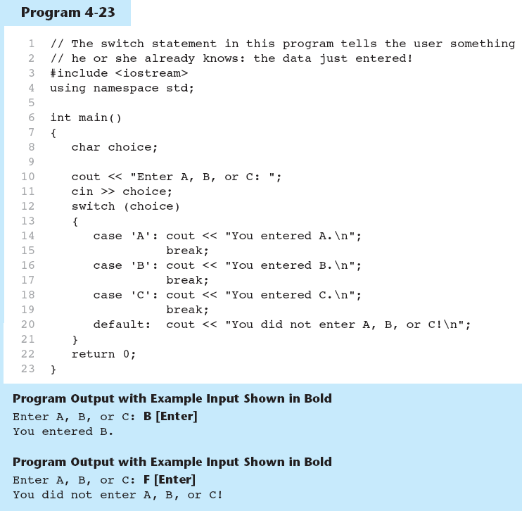
The switch Statement in Program

Slide 48
switch Statement Requirements
1) expression must be an integer variable or an expression that evaluates to an integer value
exp1 through expn must be constant integer expressions or literals, and must be unique in the switch statement
default is optional but recommended

Slide 49
switch Statement-How it Works
1) expression is evaluated
The value of expression is compared against exp1 through expn.
If expression matches value expi, the program branches to the statement following expi and continues to the end of the switch
If no matching value is found, the program branches to the statement after default:

Slide 50
break Statement
Used to exit a switch statement
If it is left out, the program "falls through" the remaining statements in the switch statement

Slide 51
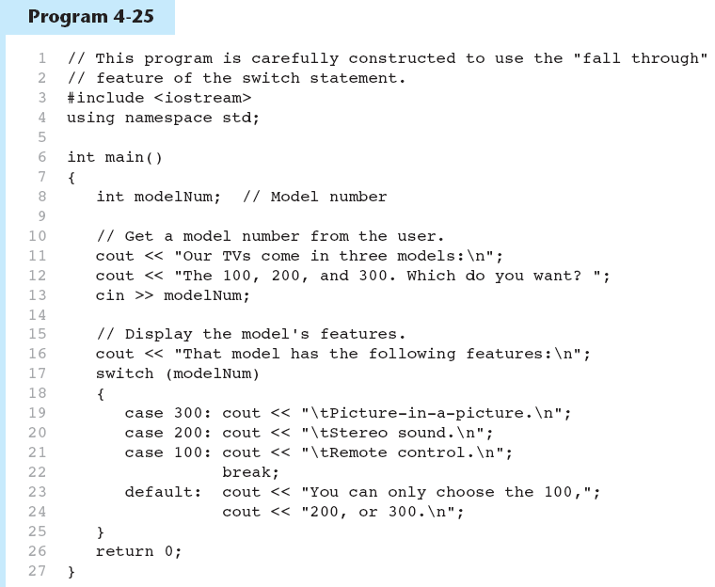
break and default statements
Continued…

Slide 52
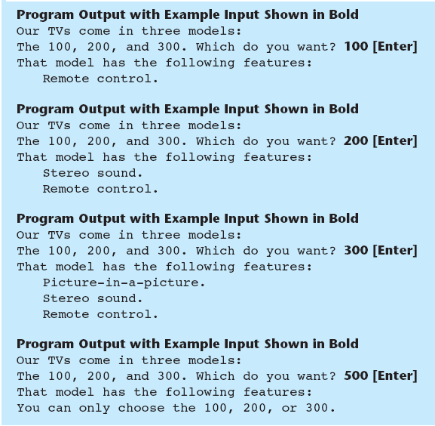
break and default statement

Slide 53
Using switch in Menu Systems
switch statement is a natural choice for menu-driven program:
  display the menu
  then, get the user's menu selection
  use user input as expression in switch statement
  use menu choices as expr in case statements

Slide 54
Logical Operators

Slide 55
Logical Operators
Used to create relational expressions from other relational expressions
Operators, meaning, and explanation:
&& | AND | New relational expression is true if both expressions are true
|| | OR | New relational expression is true if either expression is true
! | NOT | Reverses the value of an expression – true expression becomes false, and false becomes true

Slide 56
Logical Operators-Examples
int x = 12, y = 5, z = -4;
(x > y) && (y > z) | true
(x > y) && (z > y) | false
(x <= z) || (y == z) | false
(x <= z) || (y != z) | true
!(x >= z) | false

Slide 57
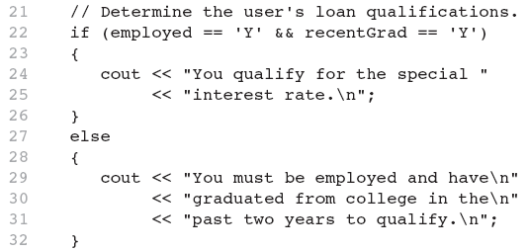
The logical && operator in Program

Slide 58
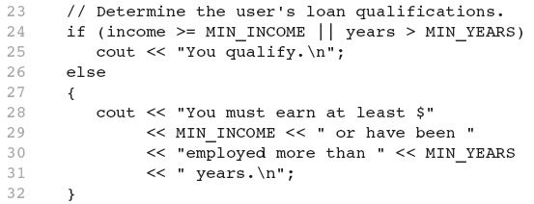
The logical || Operator in Program

Slide 59
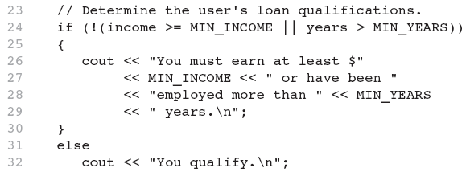
The logical ! Operator in Program

Slide 60
Logical Operator-Notes
! has highest precedence, followed by &&, then ||
If the value of an expression can be determined by evaluating just the sub-expression on left side of a logical operator, then the sub-expression on the right side will not be evaluated (short circuit evaluation)

Slide 61
More About Blocks and Scope

Slide 62
More About Blocks and Scope
Scope of a variable is the block in which it is defined, from the point of definition to the end of the block
Usually defined at beginning of function
May be defined close to first use

Slide 63
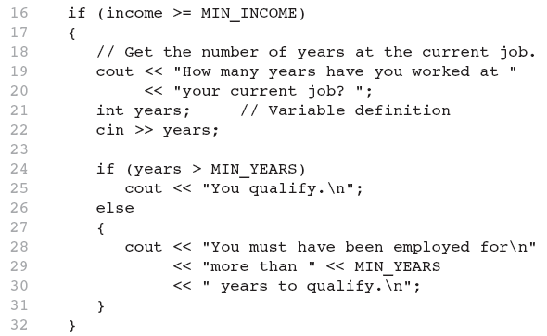
Inner Block Variable Definition in Program 4-29

Slide 64
Variables with the Same Name
Variables defined inside { } have local or block scope
When inside a block within another block, can define variables with the same name as in the outer block.
  When in inner block, outer definition is not available
  Not a good idea

Slide 65
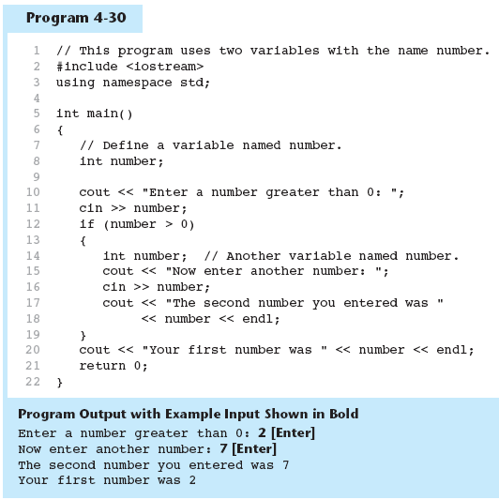
Two Variables with the Same Name

Slide 66
Flags

Slide 67
Flags
Variable that signals a condition
Usually implemented as a bool variable
Can also be an integer
  The value 0 is considered false
  Any nonzero value is considered true
As with other variables in functions, must be assigned an initial value before it is used

